Slide 1
Campus Bluetooth tag network
Notes:
Outline:
Introduce idea of senior design
Tell them what we have:
Explain Tile/BLE/CrowdGPS - reduces loss and theft?
We're doing that, but open source, so no paying a contractor and we have total control. (branding)
These are some things we're doing better:
Security
Fixed scanners - customizing to campus
Improves on tile because of density of students
Things we'd like their opinion on:
Heatmap: How many students in a given place over time.
Heatmap 2: Tell VCUPD areas which need to be patrolled to check for lost items.
Report lost/stolen items to police
Track VCU property
Cost
Ask them for their ideas/requests.

Slide 2
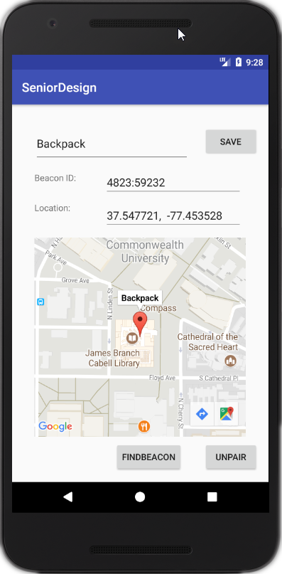
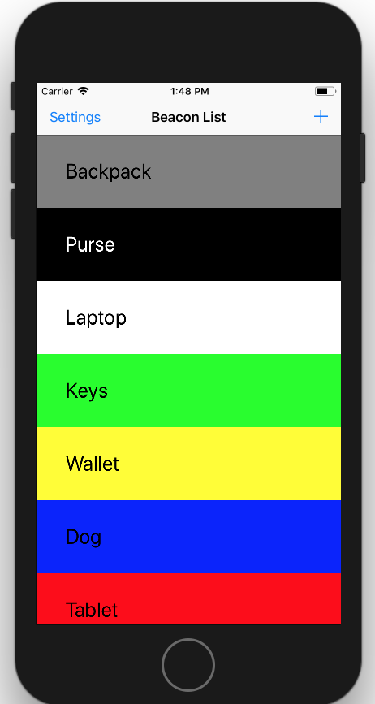
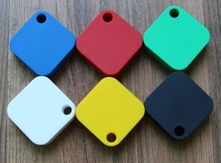



Slide 3

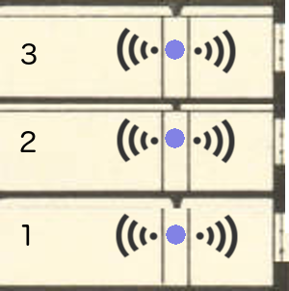


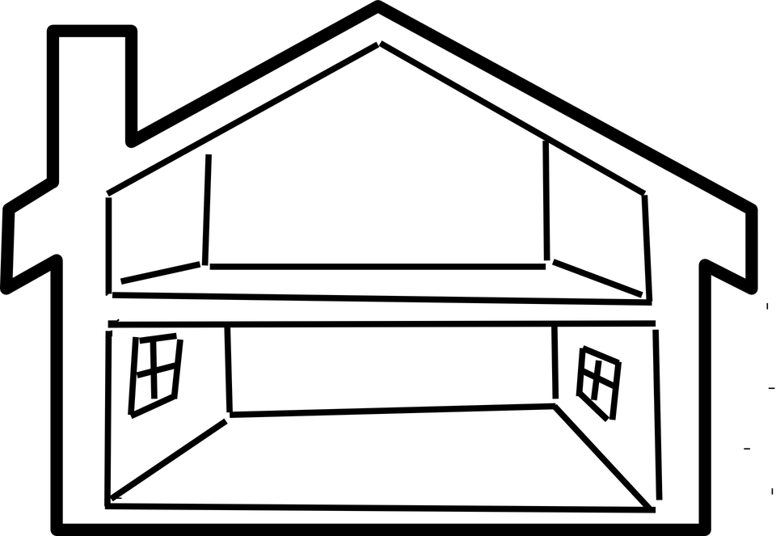
Fixed Receivers

Slide 4
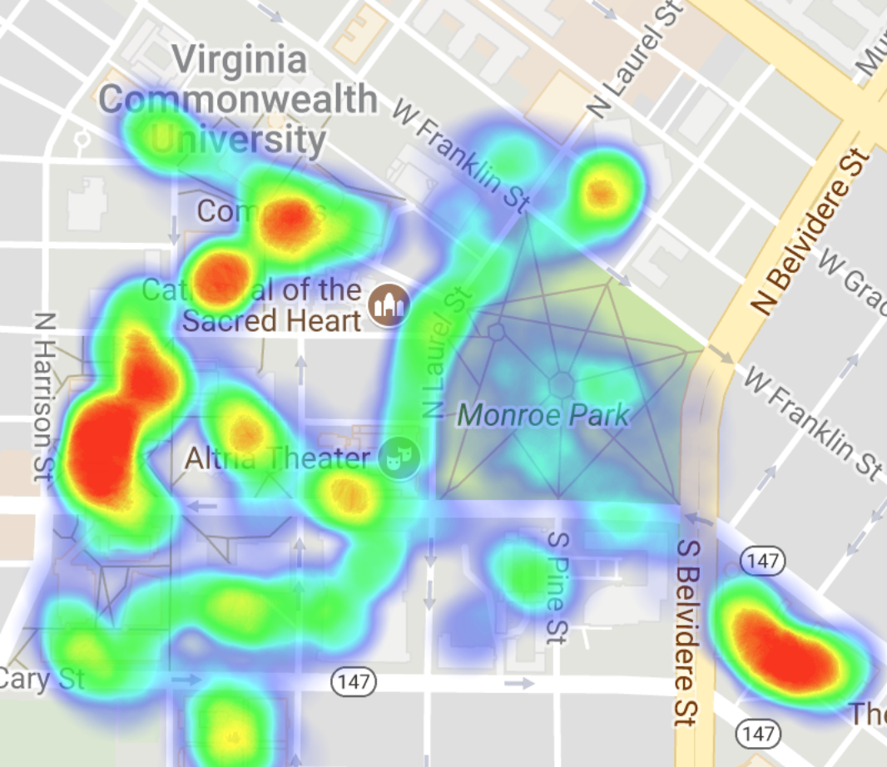
Notes:
Officers routinely patrol campus. And incredibly common reports are of lost items and stolen items.
This will give a special screen available on the phones of officers to see a heatmap of traffic around campus.
Officers can direct their patrols to less trafficked areas, because these are areas where undiscovered lost items may be found.
If lost items are observed, owners are notified via the app.

Slide 5
Heatmap: Tracking density in buildings/areas over time
Other statistics
Map potential patrol routes
Report lost tagged items to police
Track school property
Cost per tag
Notes:
We paid $11.
Our manufacturer can go to $6.50

